Slide 1

HMR Institute of Technology and
Management New Delhi- 110036
(Affiliated to Guru Gobind Singh Indraprastha University, New Delhi)
Summer Training Project
Presentation 2020 - 2021
B.Tech ECE
Presented By:
Ashish Negi (42213302818)

Slide 2

Training course:-
Introduction To Python
Programming
( National Institute of Electronics &
Information Technology)

Slide 3
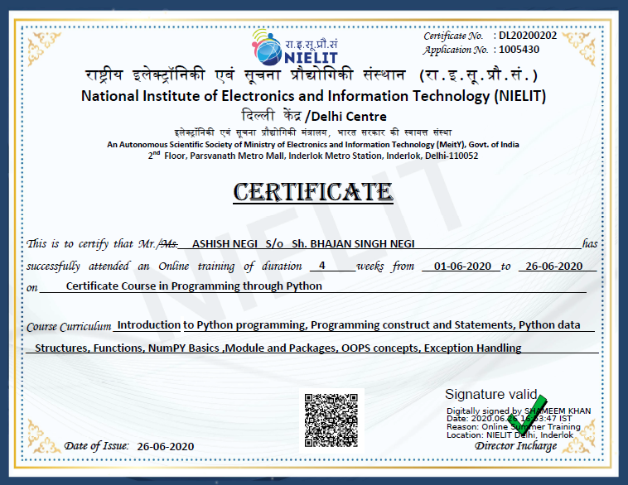
SUMMER TRAINING CERTIFICATE

Slide 4
Overview of Training Course
NIELIT an IT corporate with clear-cut strategies and its various operations are aimed at giving its customers a total package of IT solutions and products.
It covers various concepts of Python Programming like Programming construct and statements, python data structures, Functions, NumPY Basics, Module and Packages, OOPs Concept, Exception Handling.
It is a course that emphasises on learning by doing thus we also develop some simple and complex projects to enhance our knowledge base.

Slide 5

What are we going to talk about today?
Fundamentals of Python Programming
Tkinter & GUI Application
Scientific Calculator Using Tkinter Module
Important things that I learnt while
doing this course
Future Scope & Advantages

Slide 6
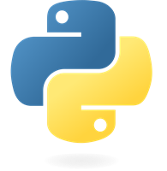
Fundamentals to
Python Programming

Slide 7

Introduction to Python Programming
Python is a Strongly typed and Dynamically typed language.
Python focuses more on readability
and productivity.
Interpreted Language
It is an Object Oriented Programming Language.
Python is a Multi-purpose language (Web, GUI, Scripting, etc.).

Slide 8

Most Common Applications of Python
Python can be used to make web-applications at a rapid rate. It is because of the frameworks Python uses to create these applications.
Python is also used in the development of interactive games. There are libraries such as PySoy which is a 3D game
engine supporting Python 3, PyGame which
provides functionality and a library for game
development.
Machine Learning and Artificial Intelligence
are the talks of the town as they yield the
most promising careers for the future.
We use Python to program desktop applications.
It provides the Tkinter library that can be used to
develop user interfaces.

Slide 9

About Tkinter

Slide 10
Tkinter
Tkinter is the standard GUI library for Python.
Python when combined with Tkinter provides a fast and easy way to create GUI applications.
Tkinter provides a powerful object-oriented interface to the Tk GUI toolkit.
Creating a GUI application using Tkinter is an easy task.
How to use Tkinter?
Import the Tkinter module.
Create The GUI Application in main window.
Add one or more of the above mentioned widgets to the GUI Application.
Enter the main event loop to take action against each event triggered by the user.

Slide 11
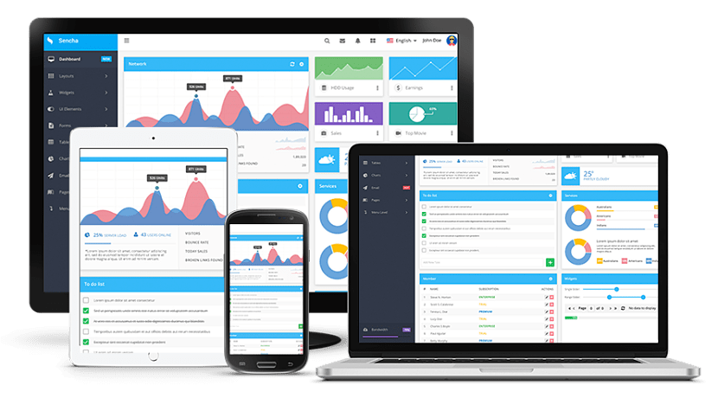
GUI Application
A graphical user interface (GUI) is a type of user interface through which users interact with electronic devices via visual indicator representations.
It allows users to interact with electronic devices through graphical icons and audio indicator such as primary notation, instead of text-based user interfaces, typed command labels or text navigation.
Advantages
You do not have to learn complicated commands
It is easy to explore and find your way around the
system using a WIMP/ GUI interface.
This type of user interface is easy to use, especially
for a beginner.

Slide 12
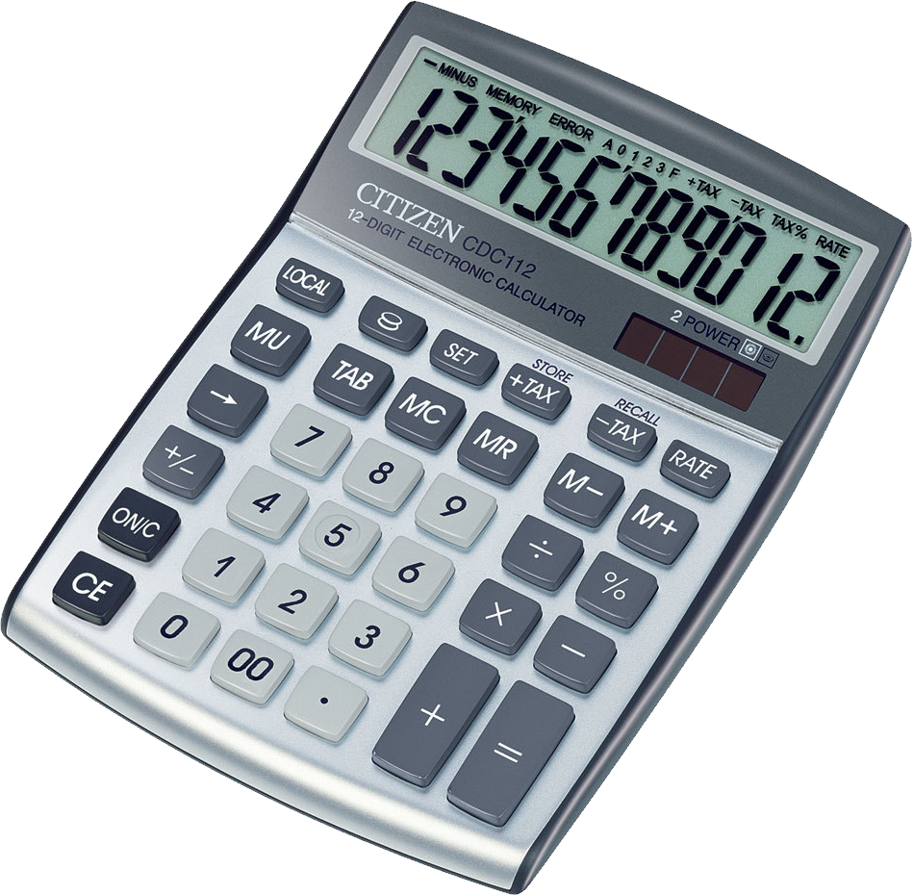
Scientific Calculator
Using Tkinter module

Slide 13
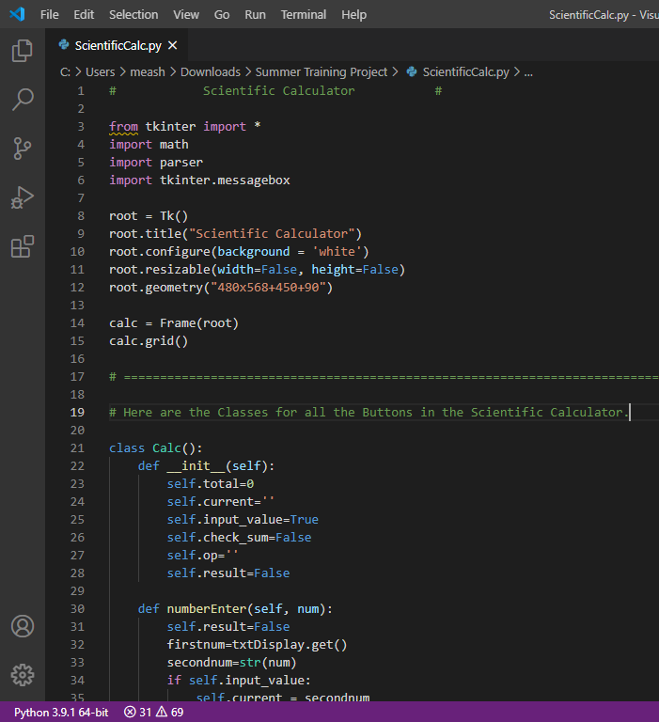
Program code
Tkinter module has been imported from the library
The Python Math Library provides us access to some common math functions and constants in Python, which we can use throughout our code for more complex mathematical computations
The tkMessageBox module is used to display message boxes in your applications. This module provides a number of functions that you can use to display an appropriate message.
root = Tk() The root window is created. The root window is a main application window in our programs. It has a title bar and borders. These are provided by the window manager.
The self in keyword in Python is used to all the instances in a class. By using the self keyword, one can easily access all the instances defined within a class, including its methods and attributes.

Slide 14
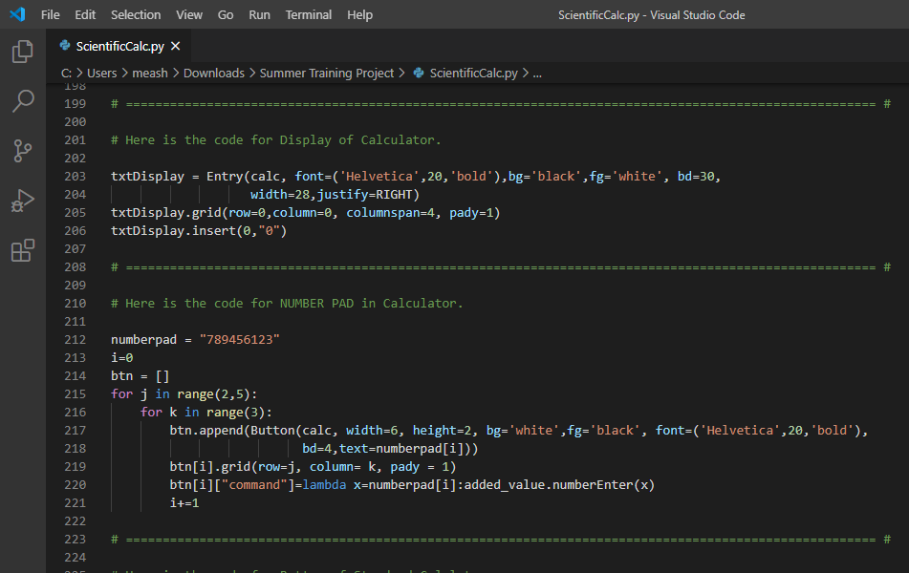
Program code
The Entry Widget is a Tkinter Widget used to Enter or display a single line of text.
The Grid geometry manager puts the widgets in a 2-dimensional table. The master widget is split into a number of rows and columns
insert() is an inbuilt function in Python that inserts a given element at a given index in a list.
The append() method in
python adds a single item to
the existing list. It doesn't
return a new list of items but
will modify the original list
by adding the item to the
end of the list.

Slide 15
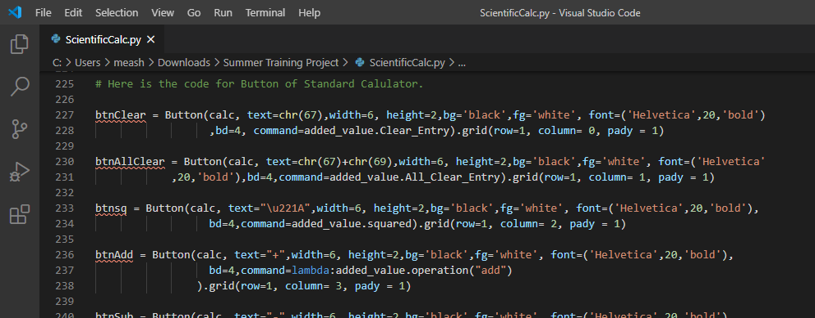
Program code
The button widget is used to add various types of buttons to the python application. Python allows us to configure the look of the button according to our requirements.
Syntax : W = Button(parent, options)
Width; The width of the button. It exists as a number of letters for textual buttons or pixels for image buttons.
Height; The height of the button. The height is represented in the number of text lines for the textual lines or the number of pixels for the images.
Bg; It represents the background color of the button.
Bd; It represents the
border width in pixels.
Fg; Foreground color
of the button.
Command; It is set to
the function call
which is scheduled
when the function is
called.

Slide 16
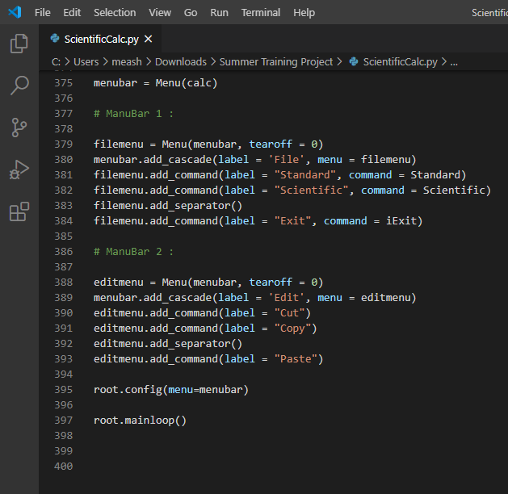
Program code
It is possible to use other extended widgets to implement new types of menus, such as the OptionMenu widget, which implements a special type that generates a pop-up list of items within a selection.
Here is the simple syntax to create this widget −
w = Menu ( master, option, ... )
master − This represents the parent window.
options − options can be used as key-value pairs separated by commas.
Tearoff: Normally, a menu can be torn off, the first position (position 0) in the list of choices is occupied by the tear-off element, and the additional choices are added starting at position 1. If you set tearoff=0, the menu will not have a tear-off feature, and choices will be added starting at position 0.

Slide 17
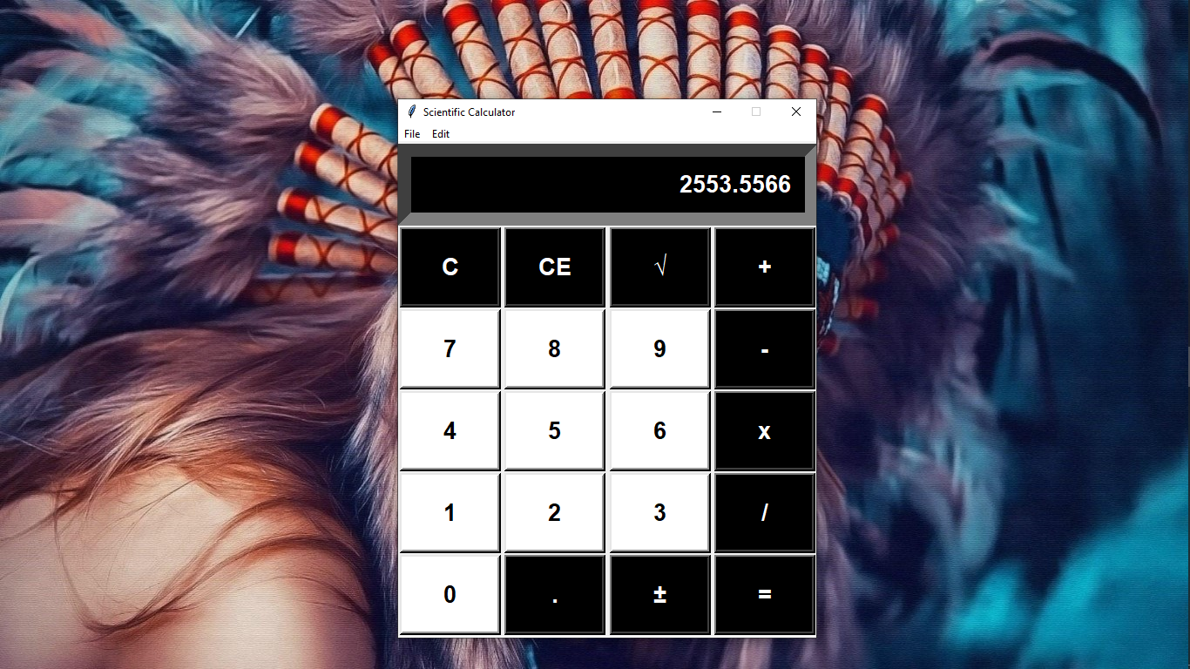
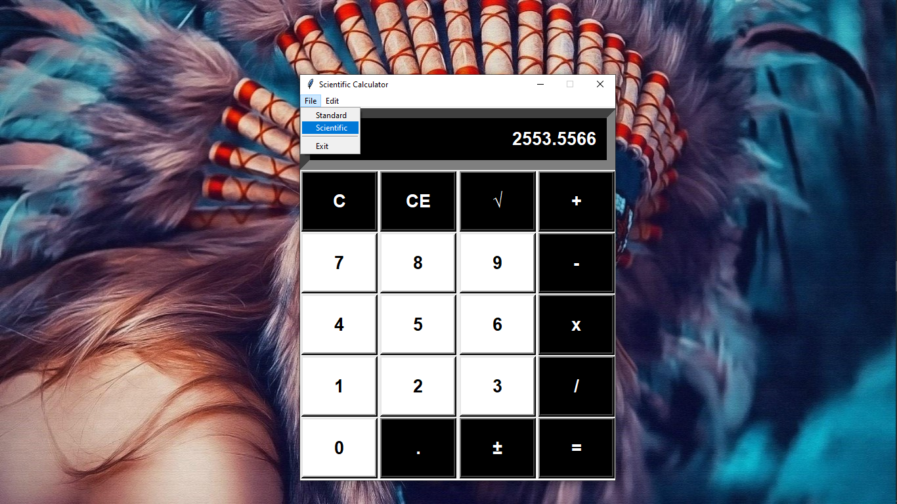
Project Outputs (Snapshots)
Fig 1. Standard calculator using python
←
Fig2. Steps to open scientific calculator
→

Slide 18
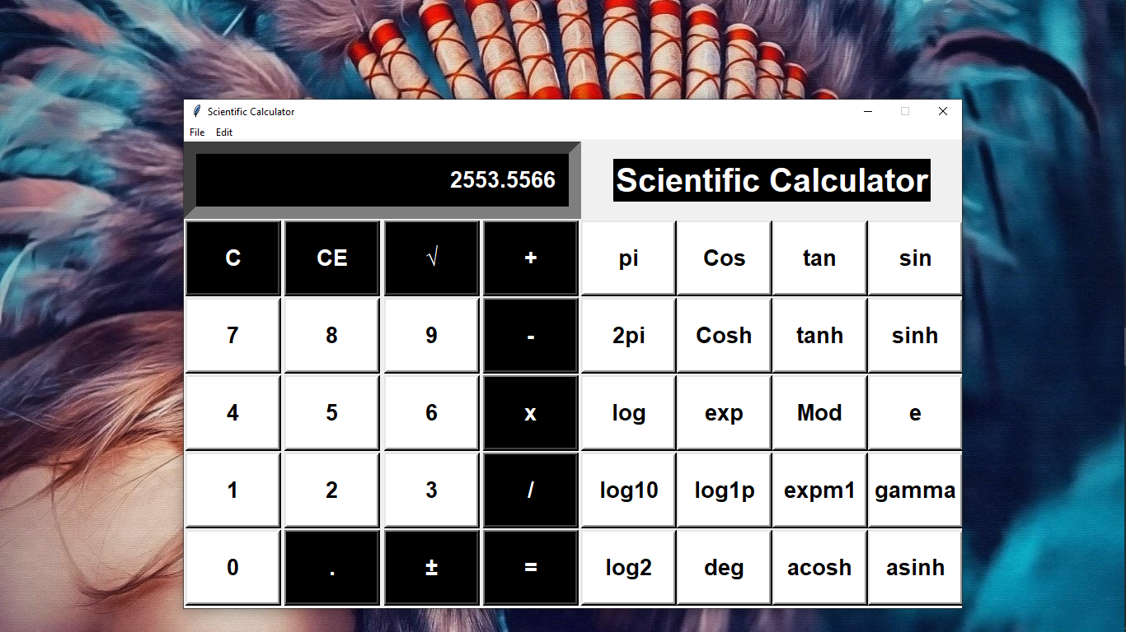
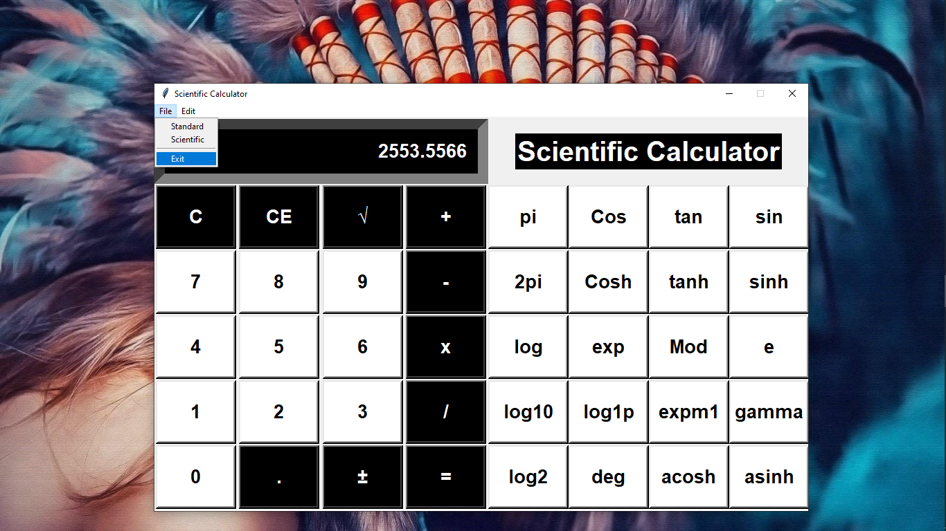
Project Outputs (Snapshots)
Fig 4.
Steps to exit
Fig 3. Scientific
calculator using python

Slide 19
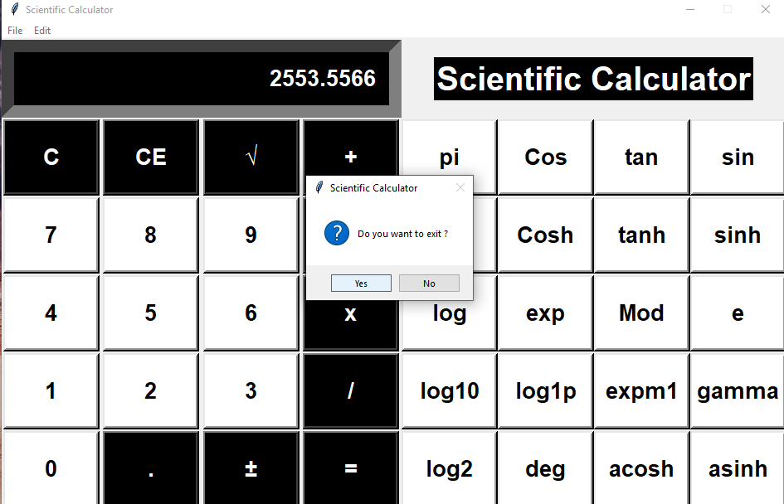
Project Outputs (Snapshots)
Fig 5. Exit messagebox

Slide 20

Major learnings

Slide 21


Major learnings
i is your best friend and you must know how to ask right questions to get the right answers.
The problems/errors you’re facing today were also experienced by other developers around the world when they were at the same stage as yours so you might find your answers at the developer forums.
Remembering everything is not possible and you just need to understand the logic behind everything so that you can understand the code you’re writing today in future.
Do test your application on real devices.
And at last

Slide 22
Future Scope & Advantages
Our project will be able to implement in future aer making some changes and modifications as we make our project at a very low level, so the modification can be done in my project are-
▪ Along with manual calculations, we can modify this calculator to make unit conversions.
▪ With the help of technology we can also modify this scientific calculator to do currency conversions.
▪ We can modify this calculator to store the history of operations.
Advantages
▪ Scientific calculators can solve complicated problems quickly and in an efficient manner.
▪ This calculator can be used to perform all basic, necessary and scientific calculations.
▪ Calculator would give more accurate results than counting manually.
▪ It makes the calculations faster than usual.

Slide 23
Thank You !!

